Slide 1
Optimizing Sales Forecasting with AI Foundation Models
Samson TAI
School of Business
Hong Kong Baptist University
Sept 28, 2024

Slide 2

Agenda
Time Series Forecasting
Time Series Forecasting Applications
Use of Foundation Models for Time Series Data Analysis

Slide 3

What is Time Series Data?
Time series is a sequence of data points collected or recorded at successive points in time, typically at uniform intervals
Source: https://www.investopedia.com/terms/t/4meseries.asp

Slide 4
Time Series Forecasting
Predicting the future based on historical patterns.
sales prediction
revenue estimates
public transport load prediction
energy usage forecasting
demand forecasting
etc.
Accurate forecasts are vital for informed decisions, boosting operational efficiency and profitability.
Notes:
Time series forecasting is a set of methods in statistics and data science to predict some variables that develop and change over time. The underlying intention of time series forecasting is determining how target variables will change in the future by observing historical data from the time perspective, defining the patterns, and yielding short or long-term predictions on how change occurs – considering the captured patterns.
Predicting customer demand is a cornerstone task for businesses that manage supplies and procurement. Another common application is predicting prices and rates for products and services that dynamically adjust prices depending on demand and revenue targets. As a travel technology consulting business, we have experience working with a Japanese retail giant, Rakuten, which also has a hospitality branch. We used Rakuten's time series data on hotel room sales as well as figures sourced from competing hotels. This data helped define the likeliest prices to increase revenue. Seasonality variables considered prices depending on weekdays, holidays, and… well, seasons. Predictions also considered general hospitality market trends.

Slide 5
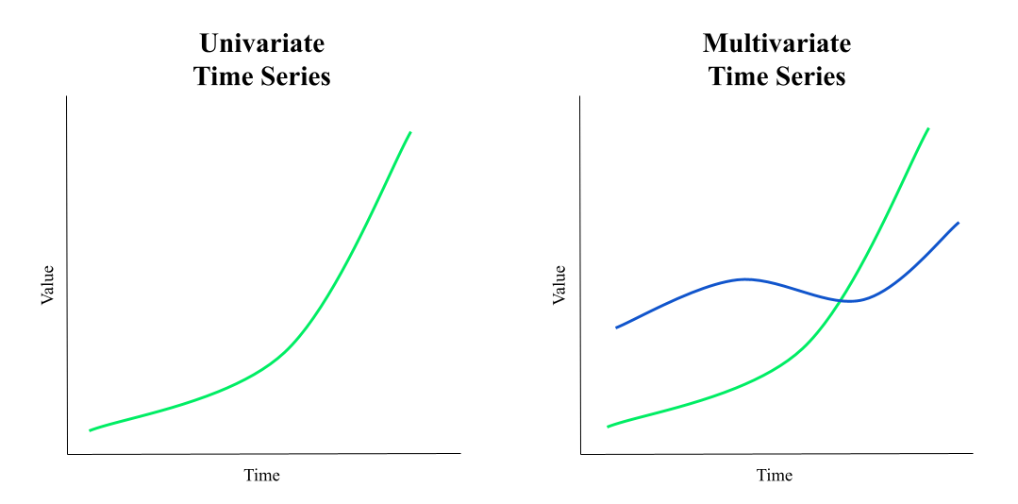
Time Series Forecasting
Univariate time series forecasting:
Uses past values of the target variable to make predictions.
Multivariate time series forecasting:
Predicts future values of one or more variables.
Analyzes historical data that includes multiple related variables over time
Source: https://www.mongodb.com/resources/basics/time-series-data-analysis
Notes:
Multivariate time series data is a collection of observed variables (cross-sectional data) that are related to each other. For example, the time series collection of the current weather may be multivariate time series data where the pooled historical data variables are temperature, humidity, wind speed, etc.
The cross-sectional data variables are not only related to their previous values but also to one another. This dependency should be considered when forecasting future trends and values.

Slide 6
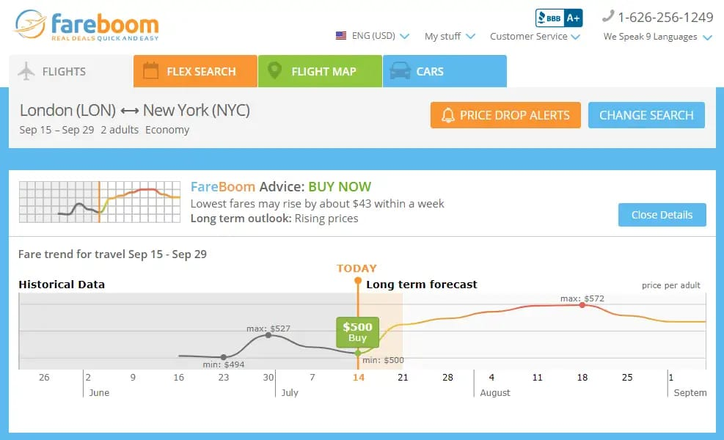
Price Prediction in Time Series Forecasting Enhances User Experience
Future Pricing Information
The engine has 75 percent confidence that the fares will rise soon. Source: Fareboom
Notes:
Price prediction in time series forecasting also produces great opportunities for improving and personalizing the user experience.
Fareboom is a flight-booking service that succeeds in finding the lowest airfares possible for its customers. The problem with airfares is that they change rapidly and without obvious reasons. Unless you’re buying tickets right before a trip, future pricing information would be advantageous.
whether the prices are going to drop or increase in the near or distant future and give this information to customers. This encourages the customer to make returns and makes Fareboom their go-to platform for optimizing their travel budgets.

Slide 7
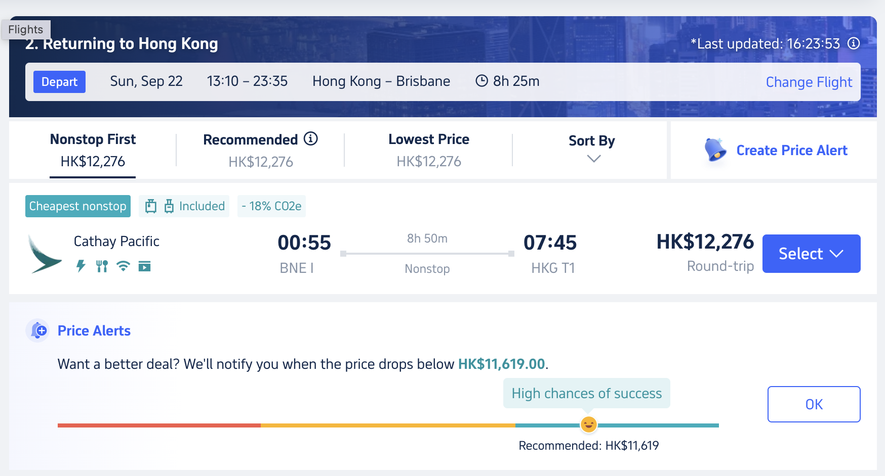
Enhancing User Experience with Price Prediction (Trip.com)
Notes:
Price prediction in time series forecasting also produces great opportunities for improving and personalizing the user experience. One of those cases is our client Fareboom.com. Fareboom is a flight-booking service that succeeds in finding the lowest airfares possible for its customers. The problem with airfares is that they change rapidly and without obvious reasons. Unless you’re buying tickets right before a trip, future pricing information would be advantageous.
A great UX solution was to predict whether the prices are going to drop or increase in the near or distant future and give this information to customers. This encourages the customer to make returns and makes Fareboom their go-to platform for optimizing their travel budgets.
Predicting customer demand is a cornerstone task for businesses that manage supplies and procurement. Another common application is predicting prices and rates for products and services that dynamically adjust prices depending on demand and revenue targets. As a travel technology consulting business, we have experience working with a Japanese retail giant, Rakuten, which also has a hospitality branch. We used Rakuten's time series data on hotel room sales as well as figures sourced from competing hotels. This data helped define the likeliest prices to increase revenue. Seasonality variables considered prices depending on weekdays, holidays, and… well, seasons. Predictions also considered general hospitality market trends.

Slide 8
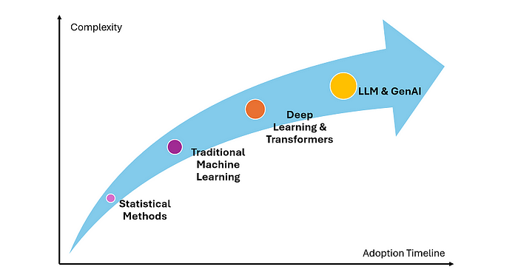
How is time series forecasting done?
Statistical methods
Machine learning models
Deep learning models
Foundation models
Notes:
The traditional machine learning approach is to split an available historic dataset into two or three smaller sets to train a model and to further validate its performance against data that a machine hasn’t seen before. If we apply machine learning without the time series factor, a data scientist can choose the most relevant records from the available data and fit the model to them, leaving noisy and inconsistent records behind.
BigQuery and Vertex AI. If you’re using the Google Cloud platform, you may access time series forecasting with its autoML tool called Vertex AI. It comes with pre-configured models with customization tools. At its core, Vertex AI leverages TensorFlow capabilities but requires far less data science expertise to operate, catering to average software engineers. On top of that, you can explore, visualize, and prepare data for time series tasks using Google’s cloud data warehousing tool BigQuery as it comes integrated with Vertex AI. Here’s Google’s tutorial for time series forecasting with Google. The main difference in time series is that a data scientist needs to use a validation set that exactly follows a training set on the time axis to see whether the trained model is good enough. The problem with non-stationary records is that data in the training set might not be homogeneous to the testing set, as time series properties substantially change over the period that training and validation sets cover.

Slide 9
Challenges in Time Series Forecasting
Data Quality
Non‐Stationarity
Computational Complexity
External Factors
Etc.
Notes:
aining dynamics and performance.
In summary, while making data stationary is crucial for classical statistical models, it is less critical for modern machine learning and deep learning models. Nevertheless, careful pre‐processing can enhance the performance of any time series forecasting model.

Slide 10
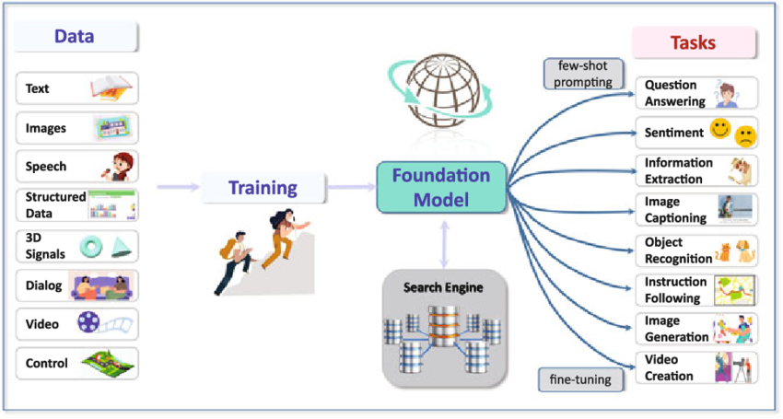
What is the Foundation Model?
Notes:
A foundation model is an AI neural network — trained on mountains of raw data, generally with unsupervised learning — that can be adapted to accomplish a broad range of tasks, t

Slide 11
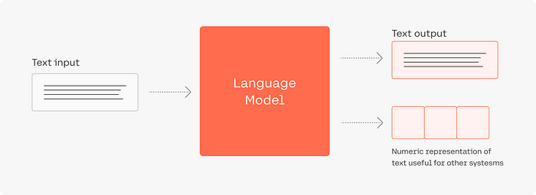
What is a Language Model?
Source: https://medium.com/@joristechtalk/demystifying-large-language-models-a-beginners-guide-to-understanding-ai-text-generation-65ef1835a787
Notes:
These models are built on a special type of machine-learning architecture known as the Transformer, and they have the ability to generate human-like text that seems almost too good to be true.

Slide 12
Source: Explanation of Prediction by Amazon Bedrock
Notes:
Based on the similar sequential formulation of time series and natural language, increasing research demonstrates the feasibility of leveraging large language models (LLM) for time series.

Slide 13
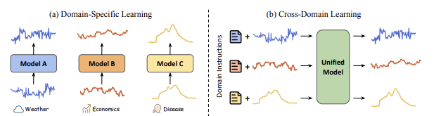
Can time series analysis benefit from the recent advances of LLMs?
Source: https://arxiv.org/pdf/2310.09751.pdf
Notes:
Based on the similar sequential formulation of time series and natural language, increasing research demonstrates the feasibility of leveraging large language models (LLM) for time series.

Slide 14
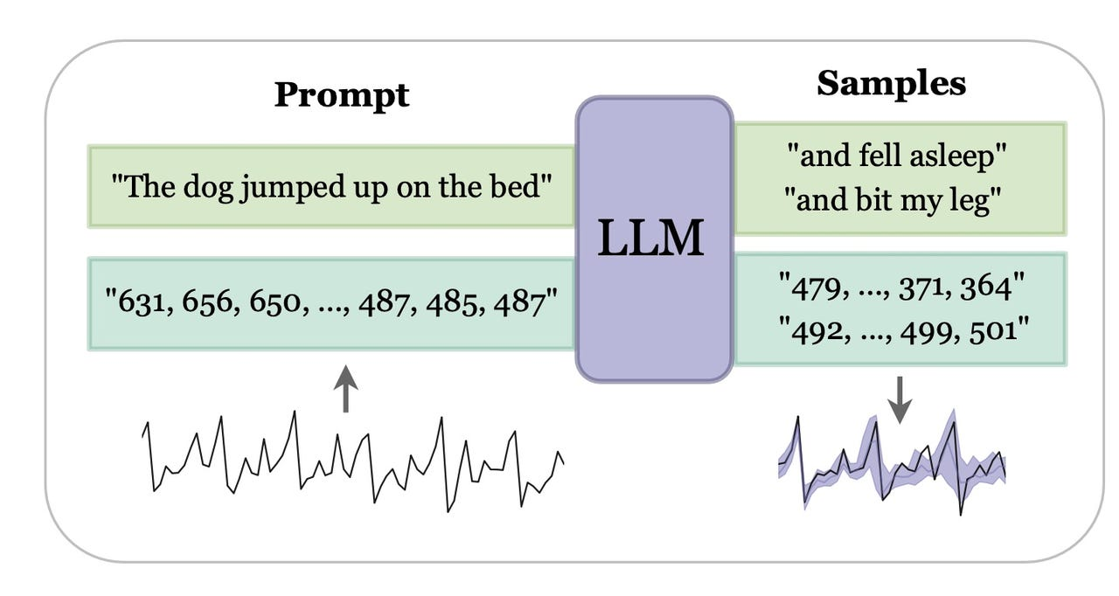
How does a Time Series Forecasting using the Foundation Model approach differ from the Traditional ML Approach?
Traditional time series forecasting models are task‐speciﬁc with limited generalization.
Foundation models oﬀer decent forecasts on unseen data without extra training.
Users can reﬁne forecasts for tasks like retail demand planning.
Notes:
https://arxiv.org/pdf/2405.02358
elopment, including datasets, open-source, time series libraries. A GitHub repository is also maintained for resource updates (https://github.com/start2020/Awesome-TimeSeries-LLM-FM).
Time series data are ubiquitous across various domains, making time series analysis critically important.
Traditional time series models are task-specific, featuring singular functionality and limited generalization capacity.
Large language foundation models have unveiled their remarkable capabilities for cross-task transferability, zero-shot/few-shot learning, and decision-making explainability.
This success has sparked interest in the exploration of foundation models to solve multiple time series challenges simultaneously.
Two main research lines, namely pre-training foundation models from scratch for time series and adapting large language foundation models for time series.

Slide 15
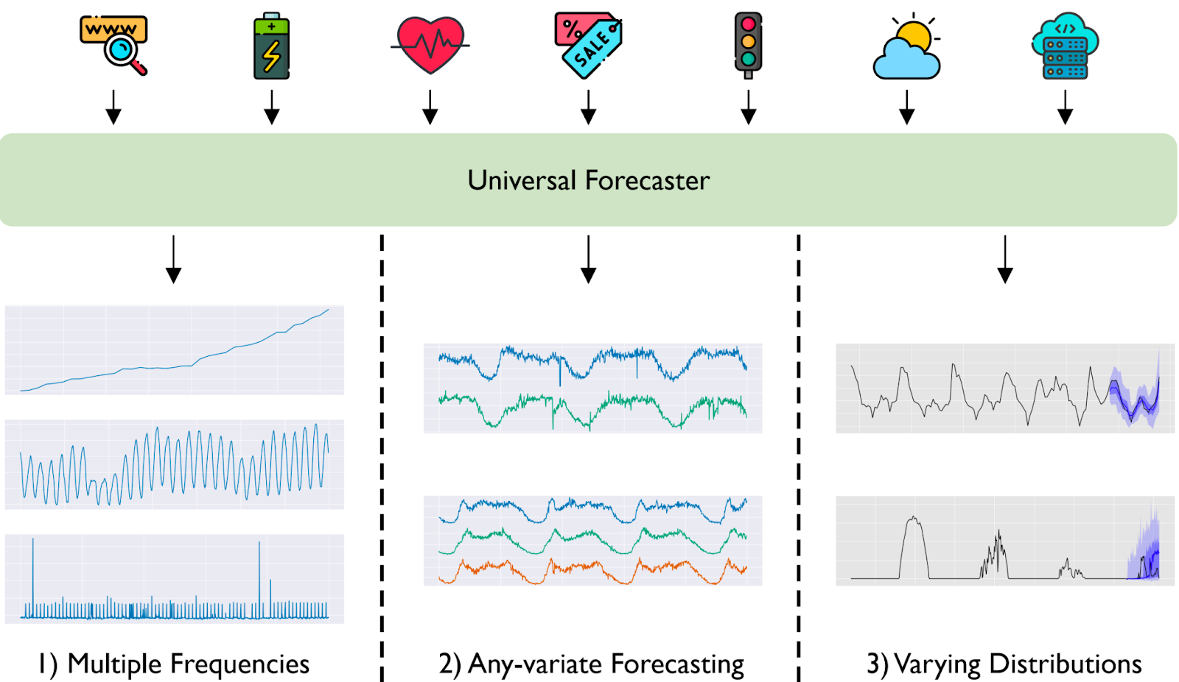
Universal Time Series Forecaster with Foundation Model
Notes:
Figure 1. A universal forecaster is a large pre-trained model capable of handling any time series forecasting problem. It is trained on a large-scale time series dataset spanning multiple domains. Compared to the existing paradigm, universal forecasting faces the three key issues of i) multiple frequencies, ii) any-variate forecasting, and iii) varying distributions.

Slide 16
Backup Slide
Foundation models of time series have not been fully developed due to the limited availability of time series corpora and the underexploration of scalable pre-training.
Traditional time series models have to be trained individually for each metric that users want to analyze. This works well, but it is challenging to scale this process to observability data, where we need to analyze a vast number of individual metrics in near real time. This scaling limitation has hindered the adoption of deep learning–based methods for time series analysis.
Large foundation models for time series are a recent development made possible by the same advances powering large language models. Unlike traditional methods, these are not trained on any one time series or domain. Rather, they are trained on a massive dataset of diverse time-series data, meaning they have observed trends across many datasets. They are more able to perform “zero-shot” predictions on new time series inputs that were not seen in their training data, while matching or even exceeding the state-of-the-art performance of full-shot models that were trained on the individual target datasets.

Slide 17
Foundation Model for Time Series
Two main research lines:
Pre-train foundation models for time series from scratch
Adapt existing large language models for time series
Large Model for TS
LLM for TS
Pre-trained FM
for TS
Source: A Survey of Time Series Foundation Models: Generalizing Time Series Representation with Large Language Model
Notes:
They have two classes, namely foundation models pre-trained from scratch for time series and adapted large language foundation models (i.e. LLM) for time series.

Slide 18
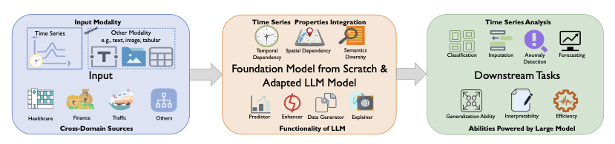
Foundation Model for Time Series
Pre-train foundation models for time series from scratch.
Adapt existing large language models for time series
Source: A Survey of Time Series Foundation Models: Generalizing Time Series Representation with Large Language Model
Notes:
They have two classes, namely foundation models pre-trained from scratch for time series and adapted large language foundation models (i.e. LLM) for time series.
Pre-train foundation models for time series from scratch.
Adapt existing large language models for time series

Slide 19
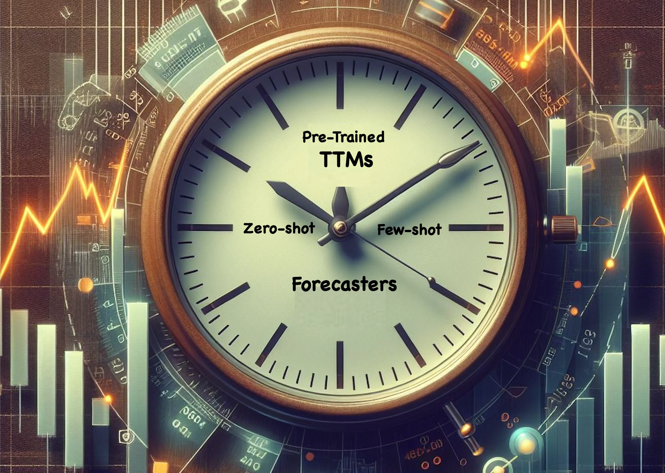
Pre-trained TS Foundation Models for Time Series Forecasting
Foundation models built specifically for time series forecasts
TimesFM (Google)
MOIRAI (Salesforce)
Tiny Time Mixers (IBM)
Chronos (Amazon)
Notes:
https://towardsdatascience.com/exploring-the-latest-advances-in-foundation-time-series-models-3fc8431ab7bd
TimesFM – decoder only TS Foundation Model: TimesFM is a forecasting model, pre-trained on a large time-series corpus of 100 billion real world time-points, that displays impressive zero-shot performance on a variety of public benchmarks from different domains and granularities.

Slide 20
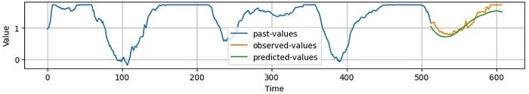
IBM TTM (pre-trained TS Foundation Model from IBM)
Pretraining phase:
pre-trained with univariate time series setting
With fewer than 1 million parameters
Finetuning phase:
Multivariate datasets are used in the fine-tuning phase.
TTM backbone remains frozen, update the weights of the TTM decoder and Forecast linear head only
Source: https://aihorizonforecast.substack.com/p/tiny-time-mixersttms-powerful-zerofew
Notes:
Pre-training — TTMs are pre-trained on a diverse set of public datasets, focusing on univariate channels initially. This stage captures general patterns across different time series data.

Slide 21
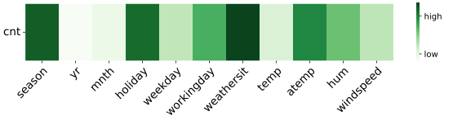
IBM TTM Explainability
Demo link: https://dsce.ibm.com/wizard/watsonx/results/watsonx-energy-forecasting#
The attention map shows the model focuses on weather variables like "weathersit" (e.g., Clear, Cloudy), "season," and "holiday" to estimate bike‐rental counts.
Notes:
One weakness of neural network-based models, let alone foundation models, is explainability and/or interpretability.
TTM’s superior design allows for natively extracting meaningful insights regarding feature importance.
At the beginning of the article, we talked about gated-attention, a mechanism that TTM uses to capture the importance of vector weights. We can leverage this mechanism to calculate an attention weight for each feature across channels — hence capturing feature importance.
Figure 6 shows the channel attention map for the UCI’s bike sharing dataset (one of the datasets with exogenous variables where TTM was evaluated):

Slide 22
TimesFM (pre-trained TS Foundation Model from Google)
The problem with building large time-series models is scarcity of data. It’s challenging to find good and diverse publicly available time-series data.
The secret sauce of TimesFM is the usage of patching (which is very beneficial for language models) with the decoder-only style of Generative Pretrained models.

Slide 23
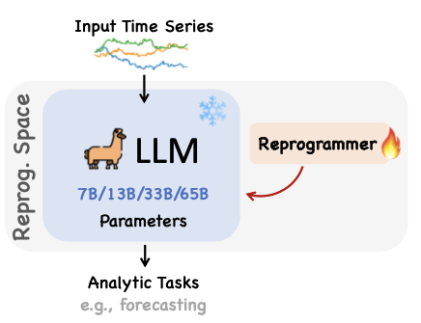
Reprogramming existing LLMs for Time Series tasks
Adapt an existing LLM model for Time Series Forecasting (e.g. LLaMA, GPT-2, etc.) for general TS forecasting.
Reprogramming ≈ Adaptation + Alignment
Adaptation makes LLMs to understand how to process the input time series data → Breaking domain isolation and enabling knowledge sharing
Alignment further eliminates domain boundary to facilitate knowledge acquiring
Notes:
Keep pre-trained LLMs intact and only fine-tune reprogrammer to achieve certain alignments
The core concept behind Time-LLM is to adapt an embedding-visible language foundation model, such as LLaMA or GPT-2. This approach is distinct from fine-tuning the LLM. Instead, we train the LLM to process an input sequence of time steps and produce forecasts for a specified time horizon, without altering the LLM itself.
At a high level, Time-LLM begins by tokenizing the input time series sequence using a customized patch embedding layer. These patches are then passed through a reprogramming layer, which effectively converts the forecasting task into a language task. Additionally, we can include a prompt prefix to enhance the model’s reasoning capability. Finally, the output patches are processed through a projection layer to generate the forecasts.

Slide 24
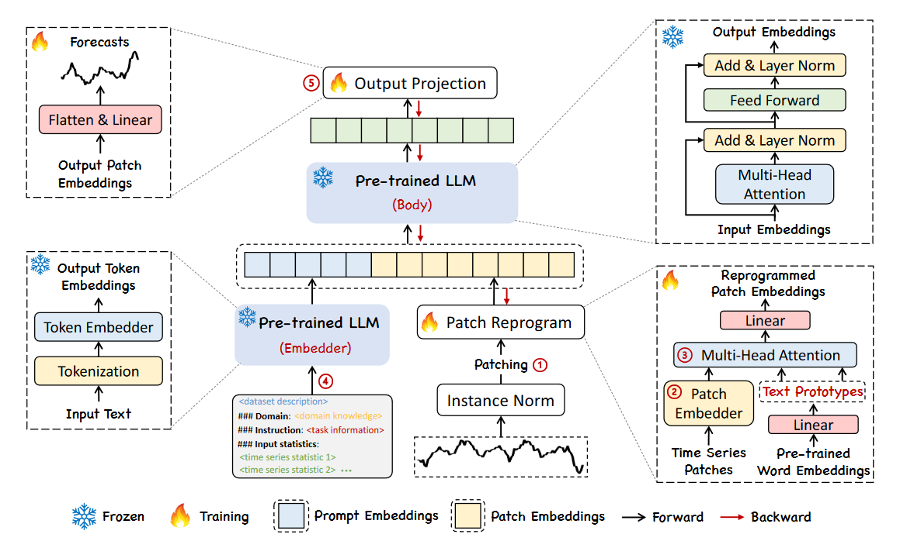
Adapt an LLM model for Time Series Forecasting
Tokenize the time series sequence with a customized patch embedding layer.
Use a reprogramming layer to translate the forecasting task into a language task.
Optionally add a prompt prefix to enhance reasoning.
Process output patches through a projection layer to get forecasts
Source: https://arxiv.org/abs/2310.01728
Notes:
Tokenize the time series sequence with a customized patch embedding layer.
Use a reprogramming layer to translate the forecasting task into a language task.
Optionally add a prompt prefix to enhance reasoning.
Process output patches through a projection layer to get forecasts

Slide 25
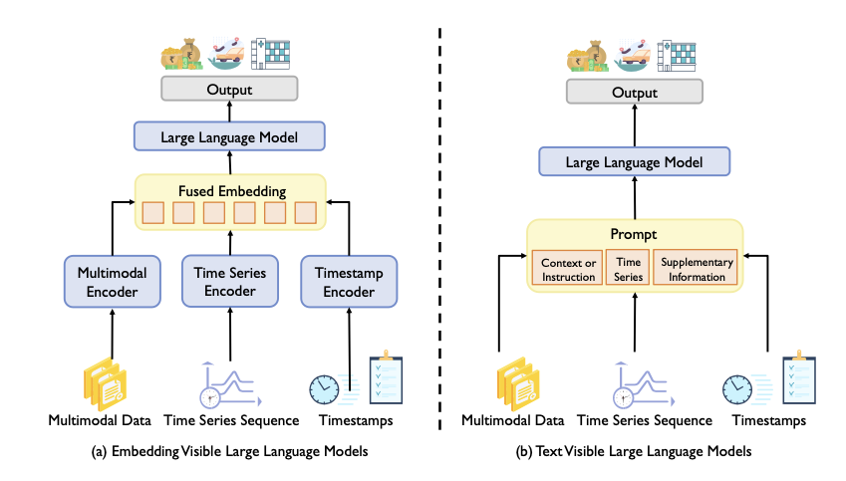
Reprogramming Large Language Model
Prefix Tuning
Patch as Prefix
Prompt as Prefix
Source: https://arxiv.org/pdf/2310.01728v2
Notes:
Reprogramming framework to adapt LLM for TS forecasting while keeping the backbone model intact.
Corer Idea:
Reprogram the input TS into text prototype representations
Propose Prompt-as-Prefix (PaP)
To further augment the model’s reasoning about TS concepts
Enrich the input TS with additional context and providing task instructions in the modality of natural language.
Output of the LLM
Projected to generate TS forecasts.

Slide 26
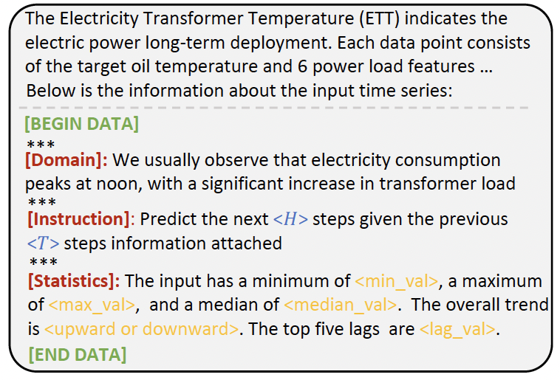
Prompt as Prefix
Prompt example. <> and <> are task-specific configurations and calculated input statistics.
Source: https://arxiv.org/pdf/2310.01728v2
Notes:
TIME-LLM: TIME SERIES FORECASTING BY REPROGRAMMING LARGE LANGUAGE MODELSFigure 4:
Prompt example. <> and <> are task-specific configurations and calculated input statistics.

Slide 27
Time Series Foundation Model in a Built-environment

Slide 28
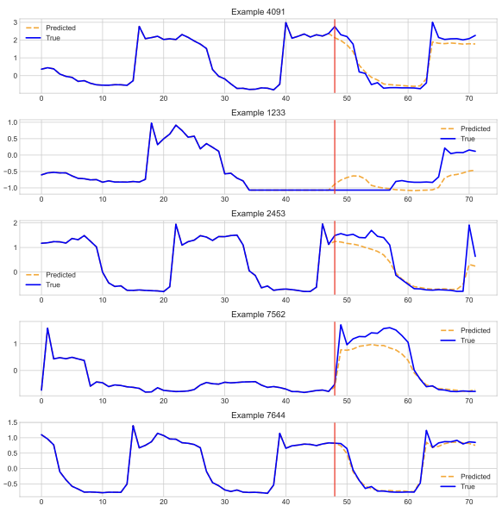
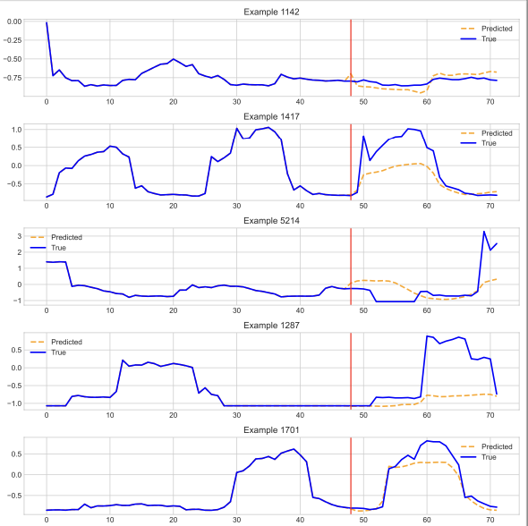
IBM TTM output

Slide 29
Remark
Foundation models have increased interest in it.
They can be applied to any time series case with great accuracy and little effort.
Time-series forecasting will become more automated in the future

Slide 30
Thank You

